Slide 1
572 Project Group 11
Yue Wang, Inaara, Zihao Sheng

Slide 2
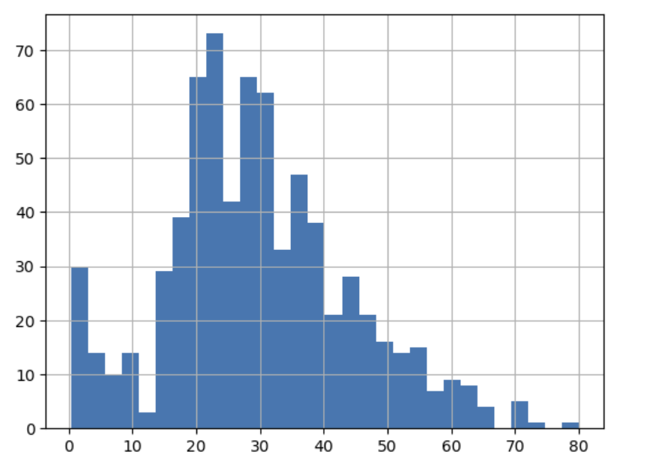
Data Preprocessing: Missing Data
From the dataset, we observe that approximately 75% of the observations have missing values for the Cabin variable.
And there are a number of passengers missing age data as well.
Therefore, we marked these passengers with two new columns: cabin_missing and age _missing.
Given that age is almost normally distributed, we also fill the missing value with mean(age)
Notes:
Let us start with the data preprocessing. The first thing we can observe is that 75% of the cabin data and a small proportion of the age data is missing. Therefore, we created two new columns, cabin_missing and age_missing to mark the missing data. From the histogram, we also observed that the age data is almost normally distributed, therefore, we also fill the missing value with mean(age)

Slide 3
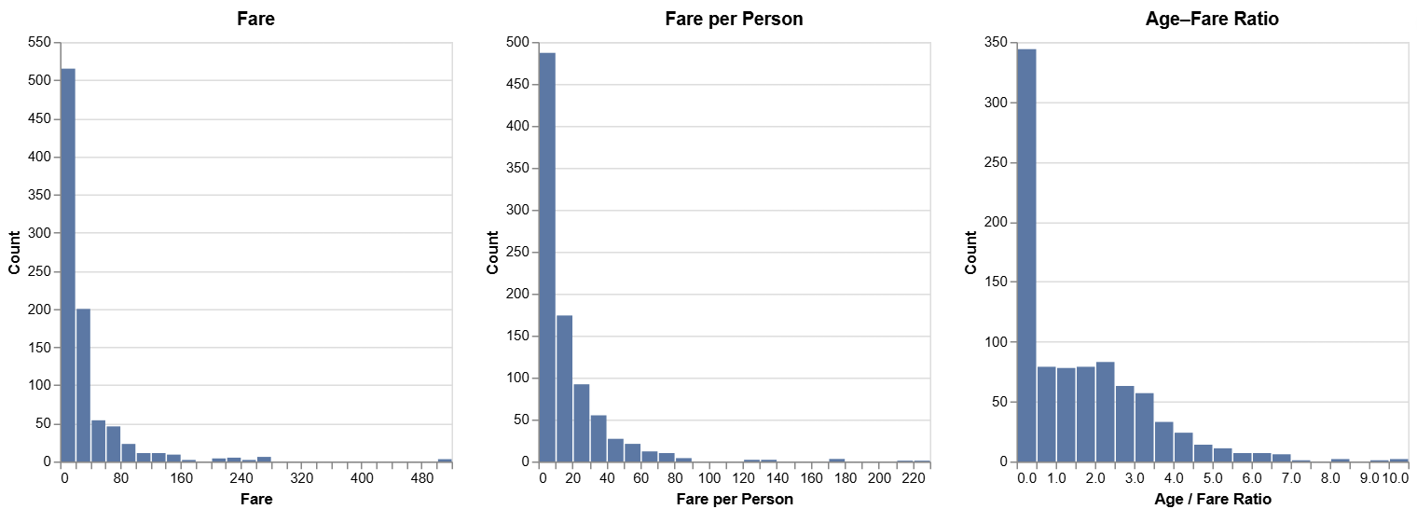
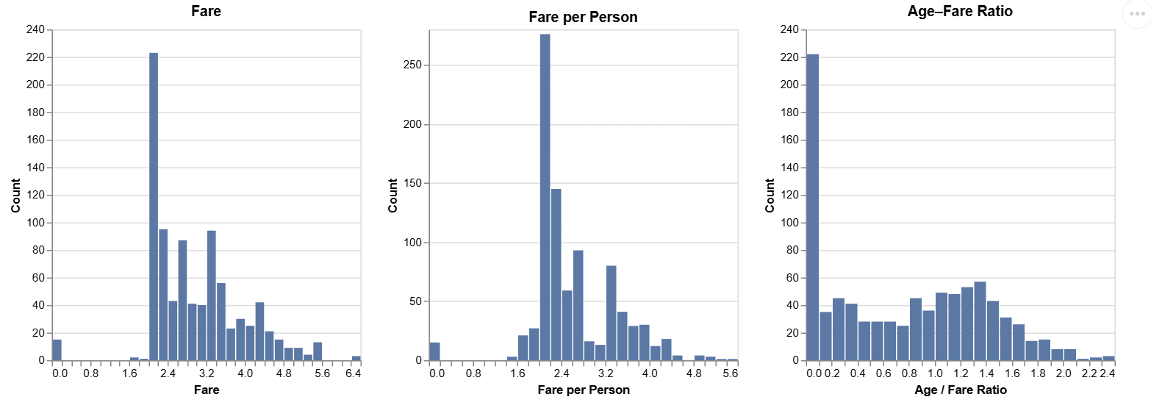
Data Preprocessing: Data Normalization
We observed that Fare, Fare per Person, Age Fare Ratio data are extremely right-skewed.
Therefore, we take the log of these data and attempt to normalize the data
From To
Notes:
We also observed that Fare, Fare per Person, Age Fare Ratio data are extremely right skewed. So we take the log of these data and attempt to normalize them.

Slide 4
Data Preprocessing: Dropping Columns
We retain cabin_score and cabin_missing as the only cabin-related features; all other cabin variables are removed.
We drop untransformed variables (Fare, fare_per_person, age_fare_ratio) and identifier fields (PassengerID, Name, Ticket, service_id, booking_reference) to avoid data leakage and redundancy.
Both title and title_group are kept for now; the final choice is left to individual modeling decisions.
title_group is a simplified (compressed) version of title.
Notes:
From the data, we see that there is already a summary data cabin_score for all the cabin information, given that the cabin data is mostly NA, we decided to use the cabin_score together with cabin_missing as our predictors for cabin. Since these two columns are the only one without missing information and having too many cabin predictors may cause multicollinearity.
We also drop the following columns to avoid data leakage and redundancy
However, we decided to keep both title and title_group, since we are not sure whether it is correct to group all the other title into one single group.

Slide 5
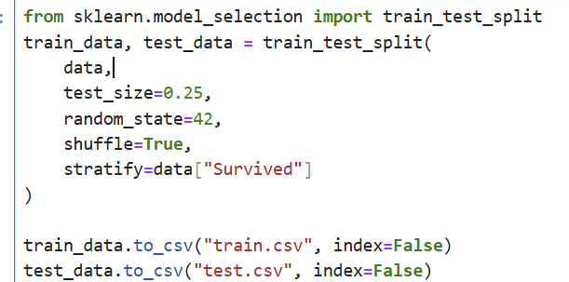
Data Preprocessing: Splitting Data and Exporting
Notes:
We then split the data into training and testing dataset, stratified by column Survived.

Slide 6
Logistic Regression Method
Why?
•Binary outcome → logistic regression is a natural choice
•Coefficients have clear interpretations (odds ratios)
•Suitable for small-to-moderate sample sizes
•Enables statistical inference and hypothesis testing
Notes:
For the first model, we picked logistic regression. Because it is well suited for binary outcomes, provides interpretable coefficients through odds ratios, performs reliably on small-to-moderate sample sizes, and supports formal statistical inference.

Slide 7
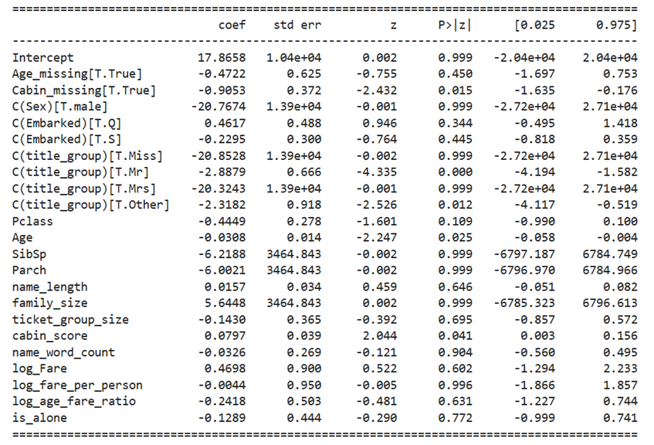
Backward Stepwise Selection with CV-AIC
•Start from a full model
•Iteratively remove predictors
•Selection based on cross-validated AIC
•Balances model fit and complexity
Notes:
We first start from a full model, and iteratively remove predictors. The selection of which predictor to remove is based on cross-validated AIC, this balances the model fit and complexity.

Slide 8
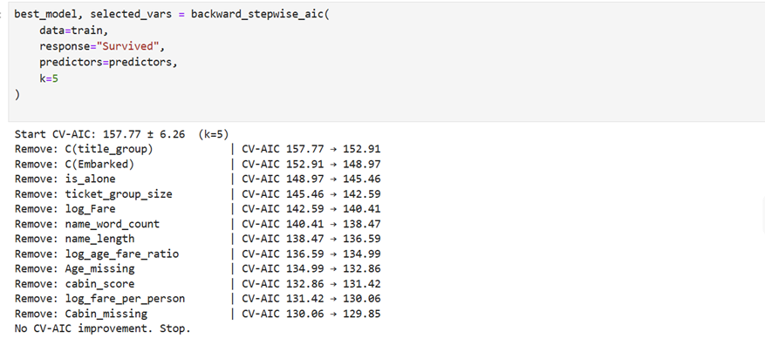
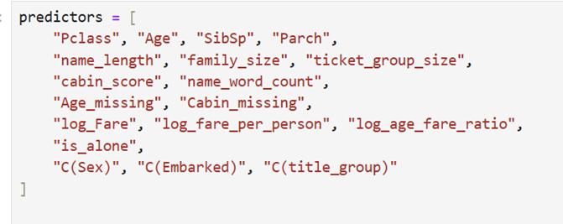
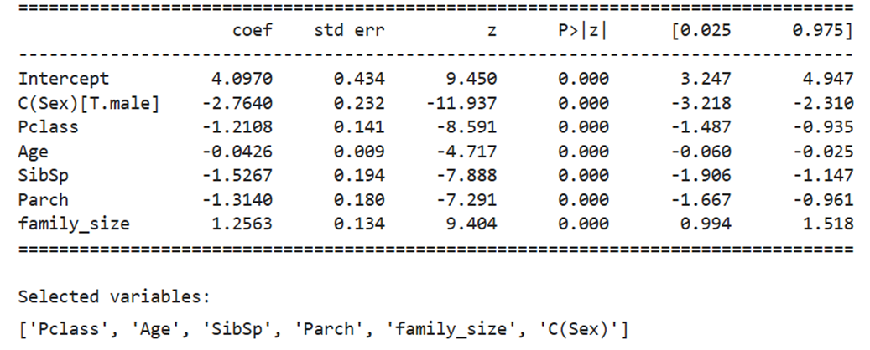
First Try of Logistic Regression Model
•We included all the variables during the first training
Notes:
For our first try, we included all the predictors, from the upper right, we can see the CV-AIC slowly decreasing, and finally gave us the selected variables, Pclass, Age, SibSp, Parch, family_size, and sex.

Slide 9
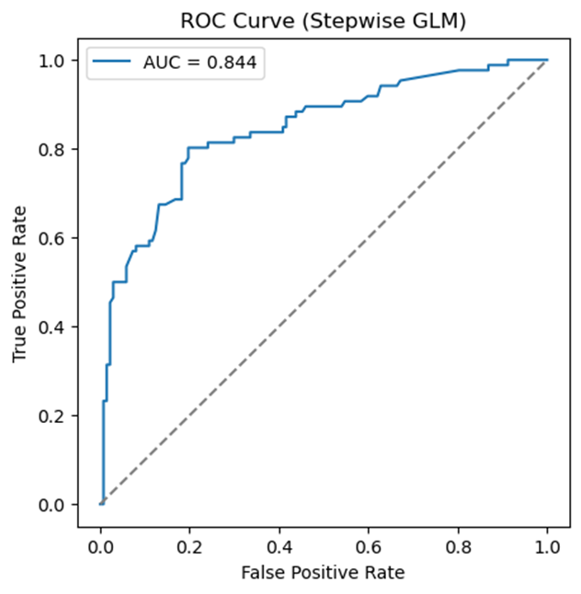
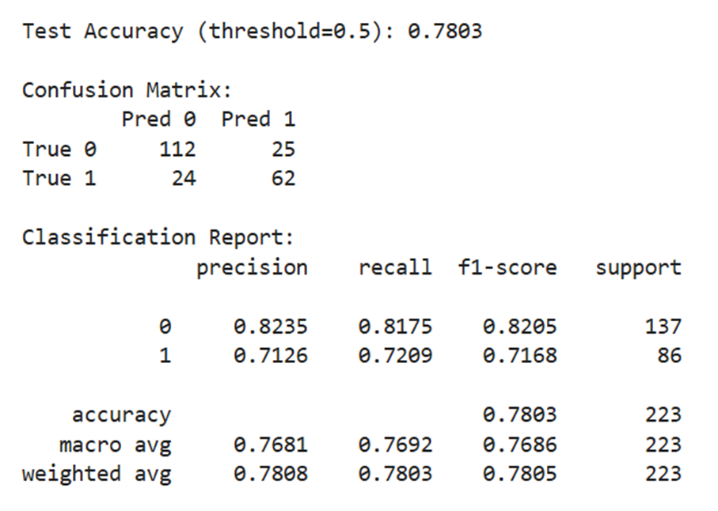
Performance on Test Data Prediction
Notes:
We use it to predict the testing dataset, and achieved an accuracy rate of 78%, but can we do better than that?

Slide 10
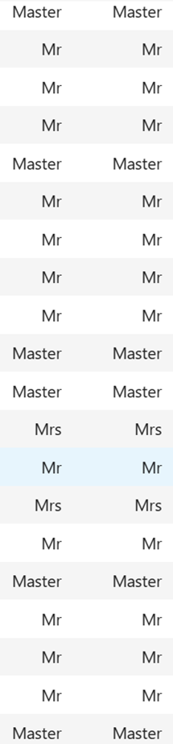
Can we do better?
•Let’s look at all the misclassified samples:
•There are 6 out of 24 passengers titled Master with Survived = 1 and were misclassified to Survived = 0
•They are misclassified because their predicted survival possibility was greatly reduced by their Male gender. However, they did have a higher survival rate due to their social status and age.
Notes:
Let’s take a look at the misclassified data, we observed that 6 out of 24 passengers titled Master were misclassified. This makes sense, since we are predicting on sex, which implies that Male passengers are unlikely to survive. However, these Master titled passengers are usually little boys with high social status. Making them more likely to survive.

Slide 11
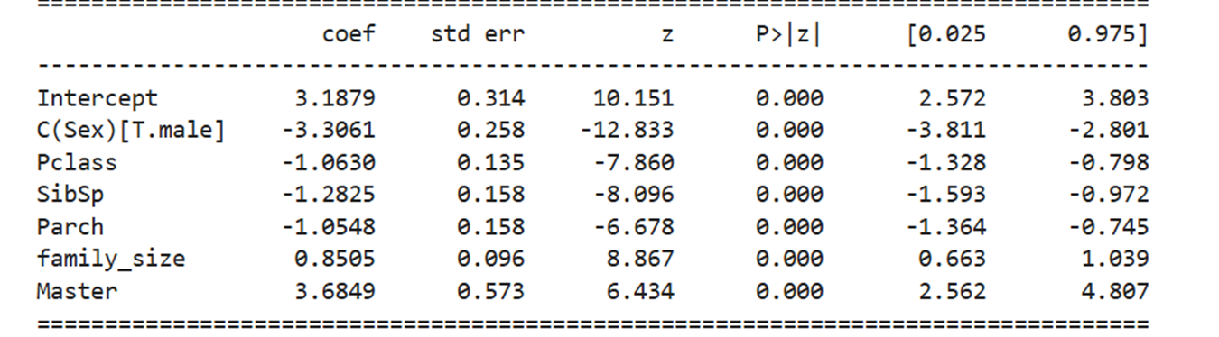
Second Try of Logistic Regression
•We add a new column ‘Master’ to determine whether the passenger is titled Master or not. Then we train the model again.
Notes:
So for our second try, we added a new column Master and retrain the model

Slide 12
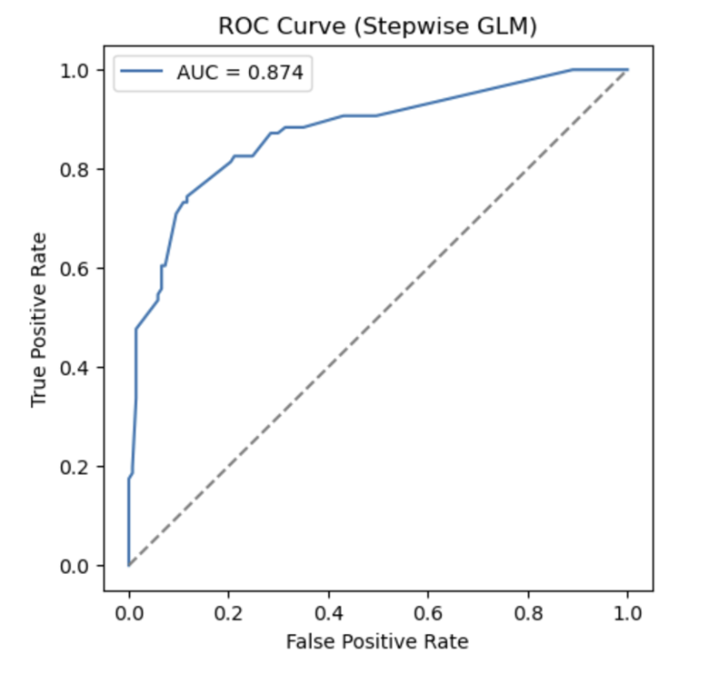
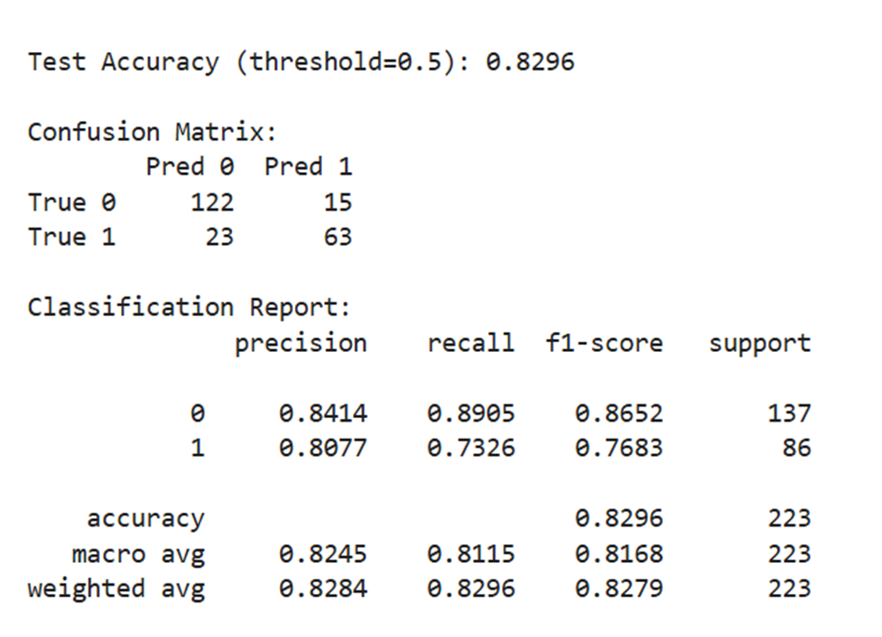
Performance on Test Data Prediction
Notes:
This time, we achieved an almost 83% accuracy rate

Slide 13
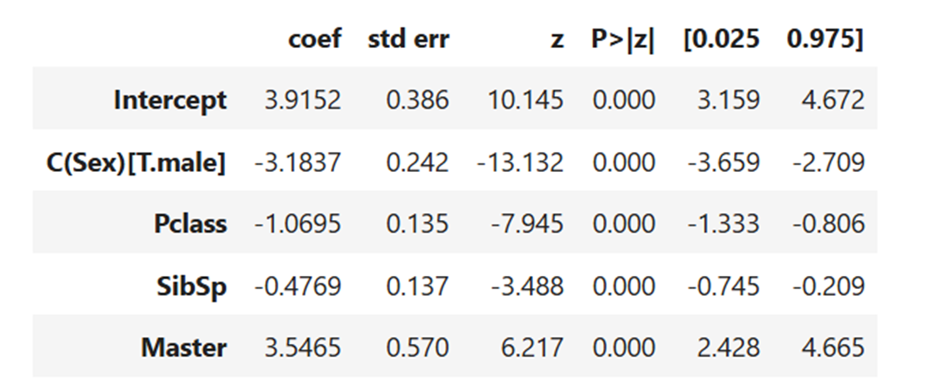
Risk of Multicollinearity (Third Try)
•Sib and Spouse + Parent and Children is highly correlated to family_size variable, can we remove one or two of them?
•Let’s remove family_size from the full_model and do the training
Notes:
However, we can see that usually for family sibling and spouse + parent and children number is highly correlated to the total family_size, we certainly don’t want to have all 3 of them, this will may multicollinearity. Let’s try to remove the family_size a retrain the model. The good news is, this time, not only family size is removed, but also the parent and children column is removed. Leaving us with only 4 predictors.

Slide 14
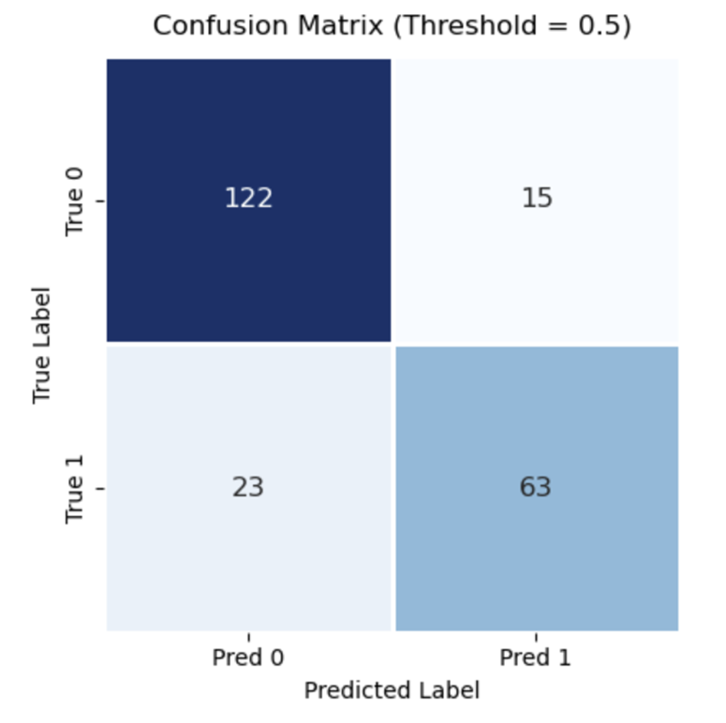
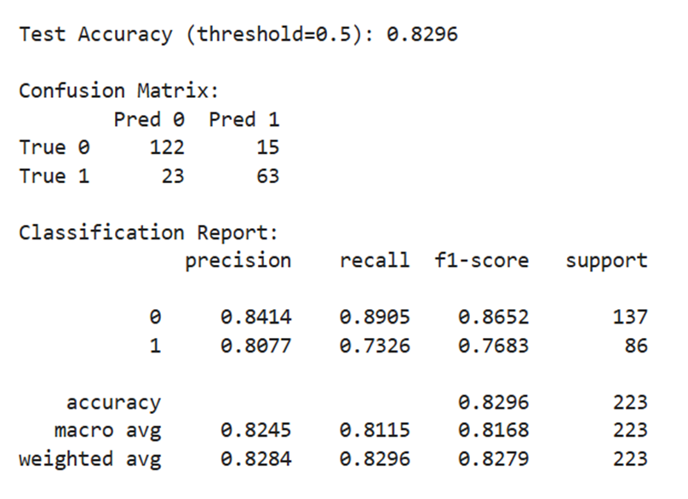
Performance on Test Data Prediction
Same accuracy rate as the second try, but fewer predictors
Notes:
After removing the predictors, we are happy to find out that the accuracy rate has not changed, which means that we have found a simple and accurate model.

Slide 15
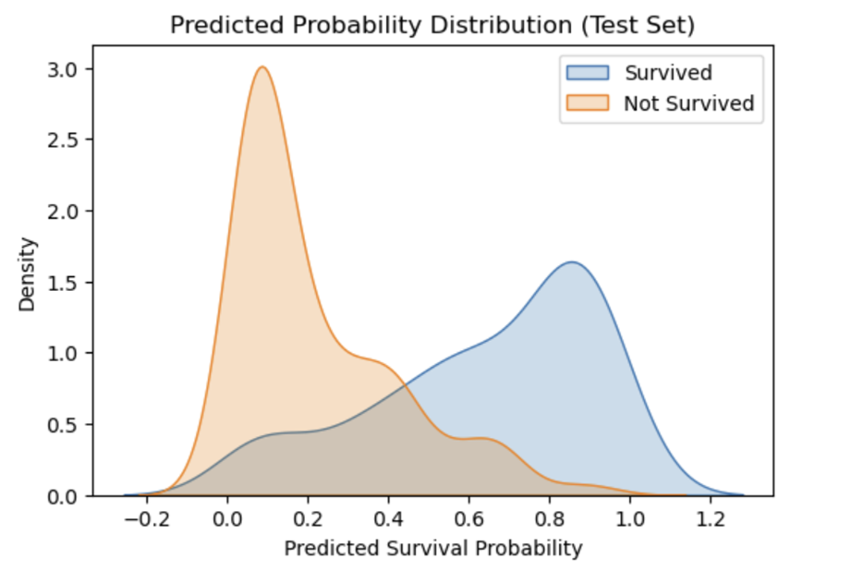
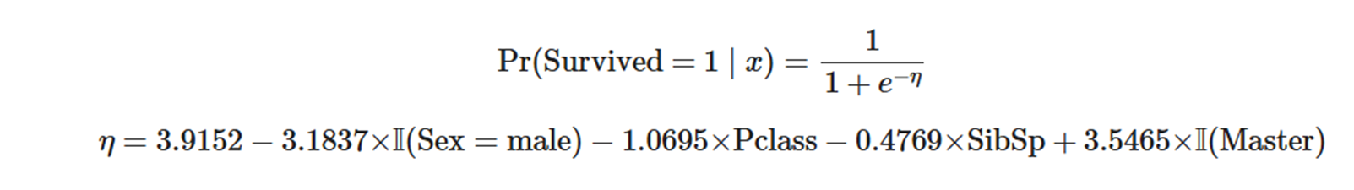
Final Model:
Notes:
So here is our final model for logistic regression. If you are female, is class 1, don not have sibling or spouse or you are a little boy titled master, you are more likely to survive.

Slide 16
Random Forest Model
We chose to do a random forest model as it’s good for prediction accuracy, can handle many kinds of predictor values, and very efficient in computational resources
Start off with a basic model with basic parameters to see general accuracy
Used CV to generate optimal parameters based on training data
Generated final model off the CV parameters, looked at accuracy, and also generated graphs

Slide 17
Feature Selection
Usually not needed as the idea of random forest has feature selection built in
Partially taken care of in hyperparameter tuning with max depth/max features

Slide 18
CV Methods
RandomSearchCV
    Randomly searches in a range of values, quick to compute
GridSearchCV
    Searches through all possibilities in a given parameter grid, computationally expensive

Slide 19
Best Parameters From RandomSearchCV

Slide 20
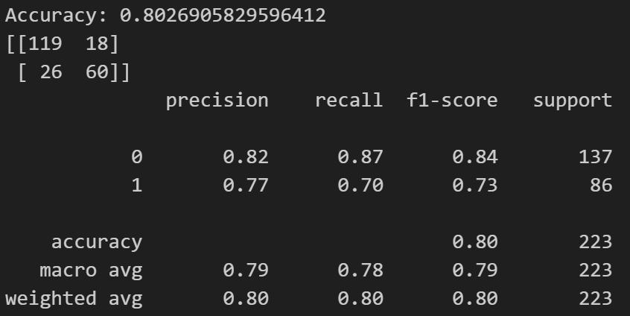
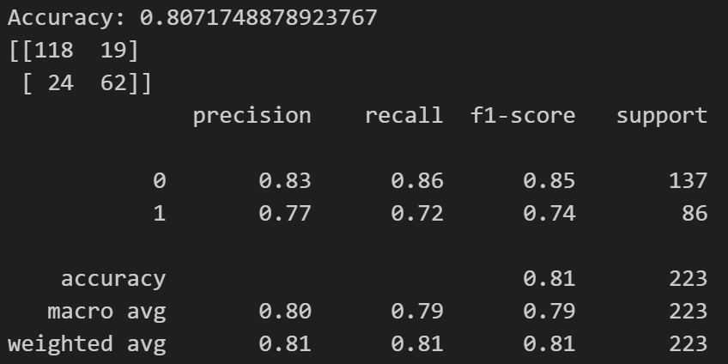
Accuracy Comparison
Basic Model CV Model

Slide 21
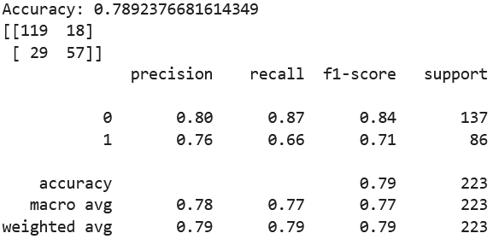
Best Parameters From GridSearchCV

Slide 22
Why RandomSearch Might Have Done Better
GridSearchCV only searches along predefined grid so if the optimal is between grid points it might miss it while RandomSearchCV is more likely to find it in that case

Slide 23
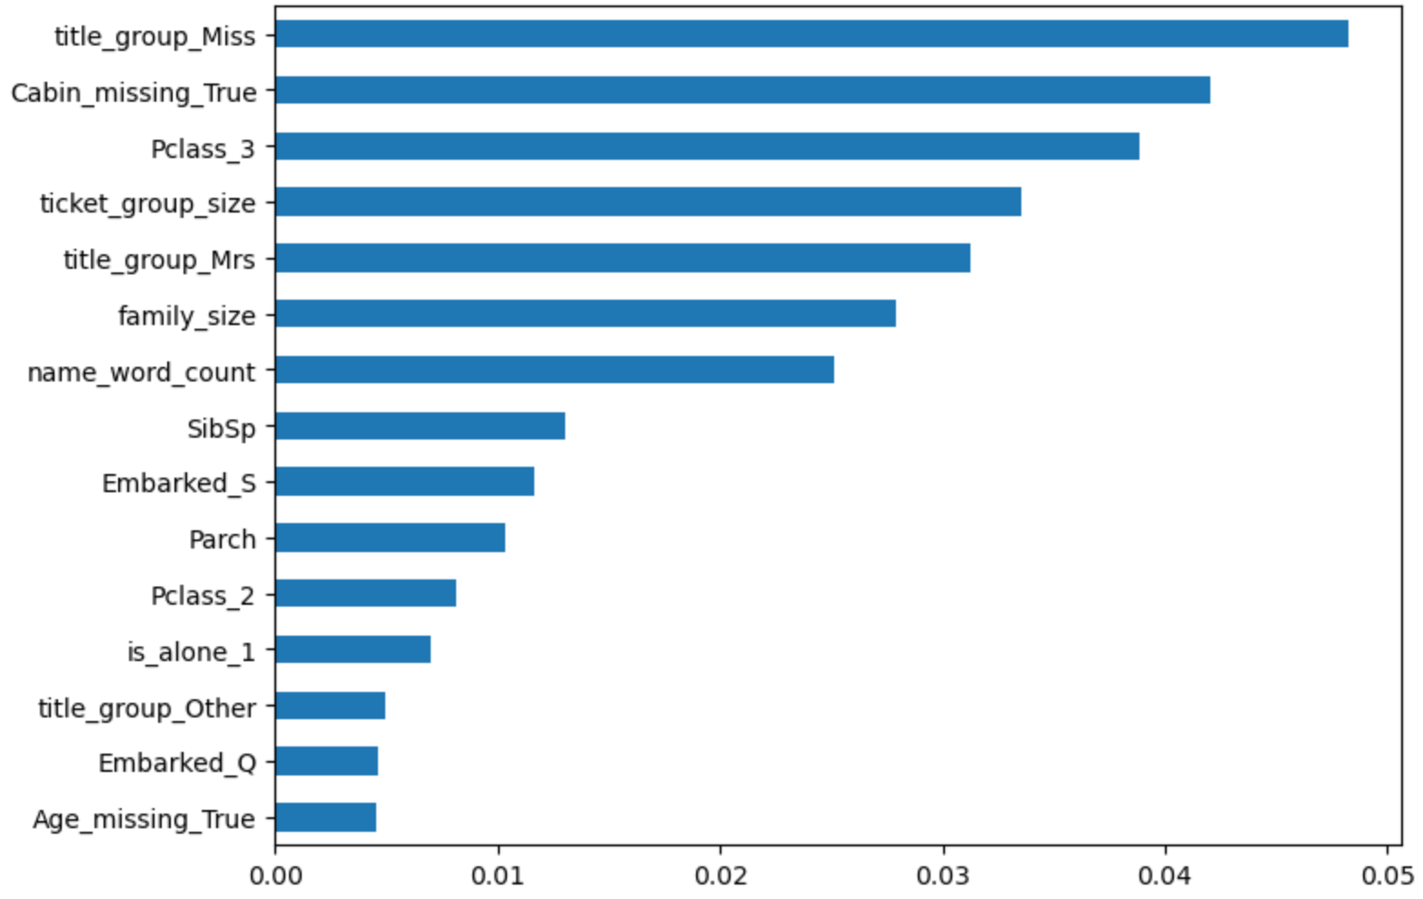
Final Importance Graph

Slide 24
Interesting Thoughts about Importance
Being female is the most important predictor as expected
Second most important predictor is if the cabin data is missing, maybe an indication of stowaways? Also historically the people who go on later tended to have a higher chance of missing data so could also be related to wealth indicator
Third most important predictor is P3 class, an indication of wealth, probably negative relation again as rich people survived more
Fourth is ticket group size, another indication of wealth

Slide 25
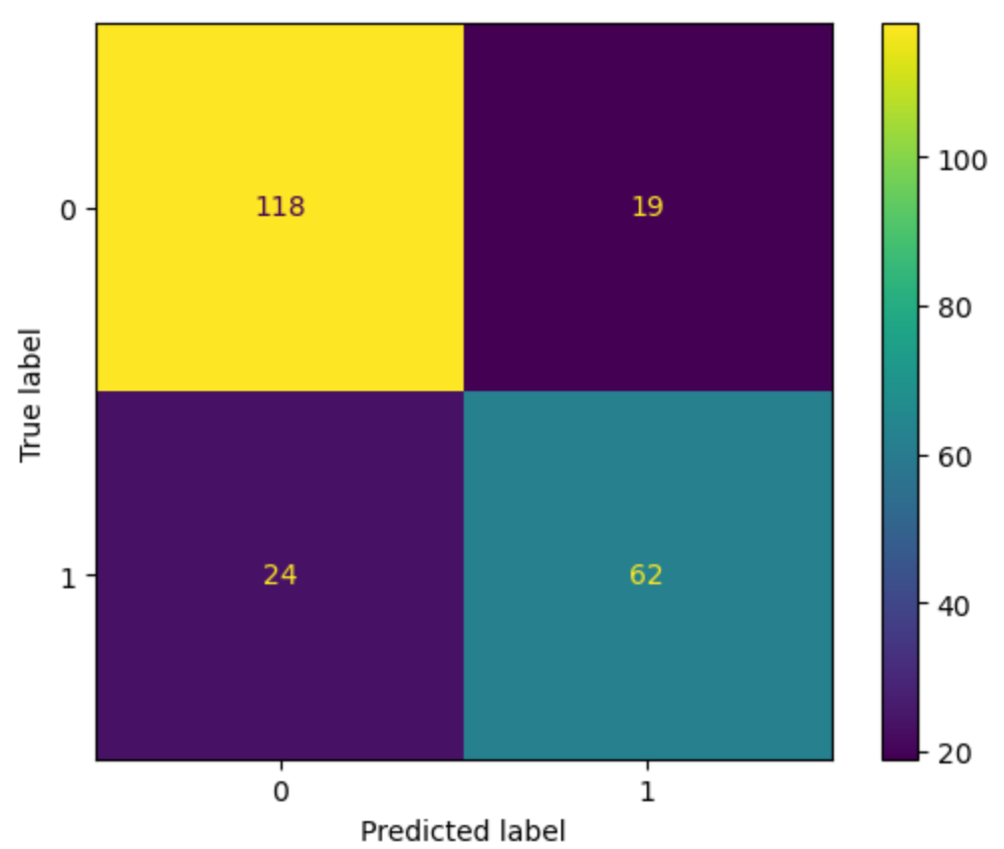
Final Confusion Matrix
Nothing too alarming in the confusion matrix
Slightly more false negatives (predicted dead when survived) than false positives (predicted survived when dead)

Slide 26
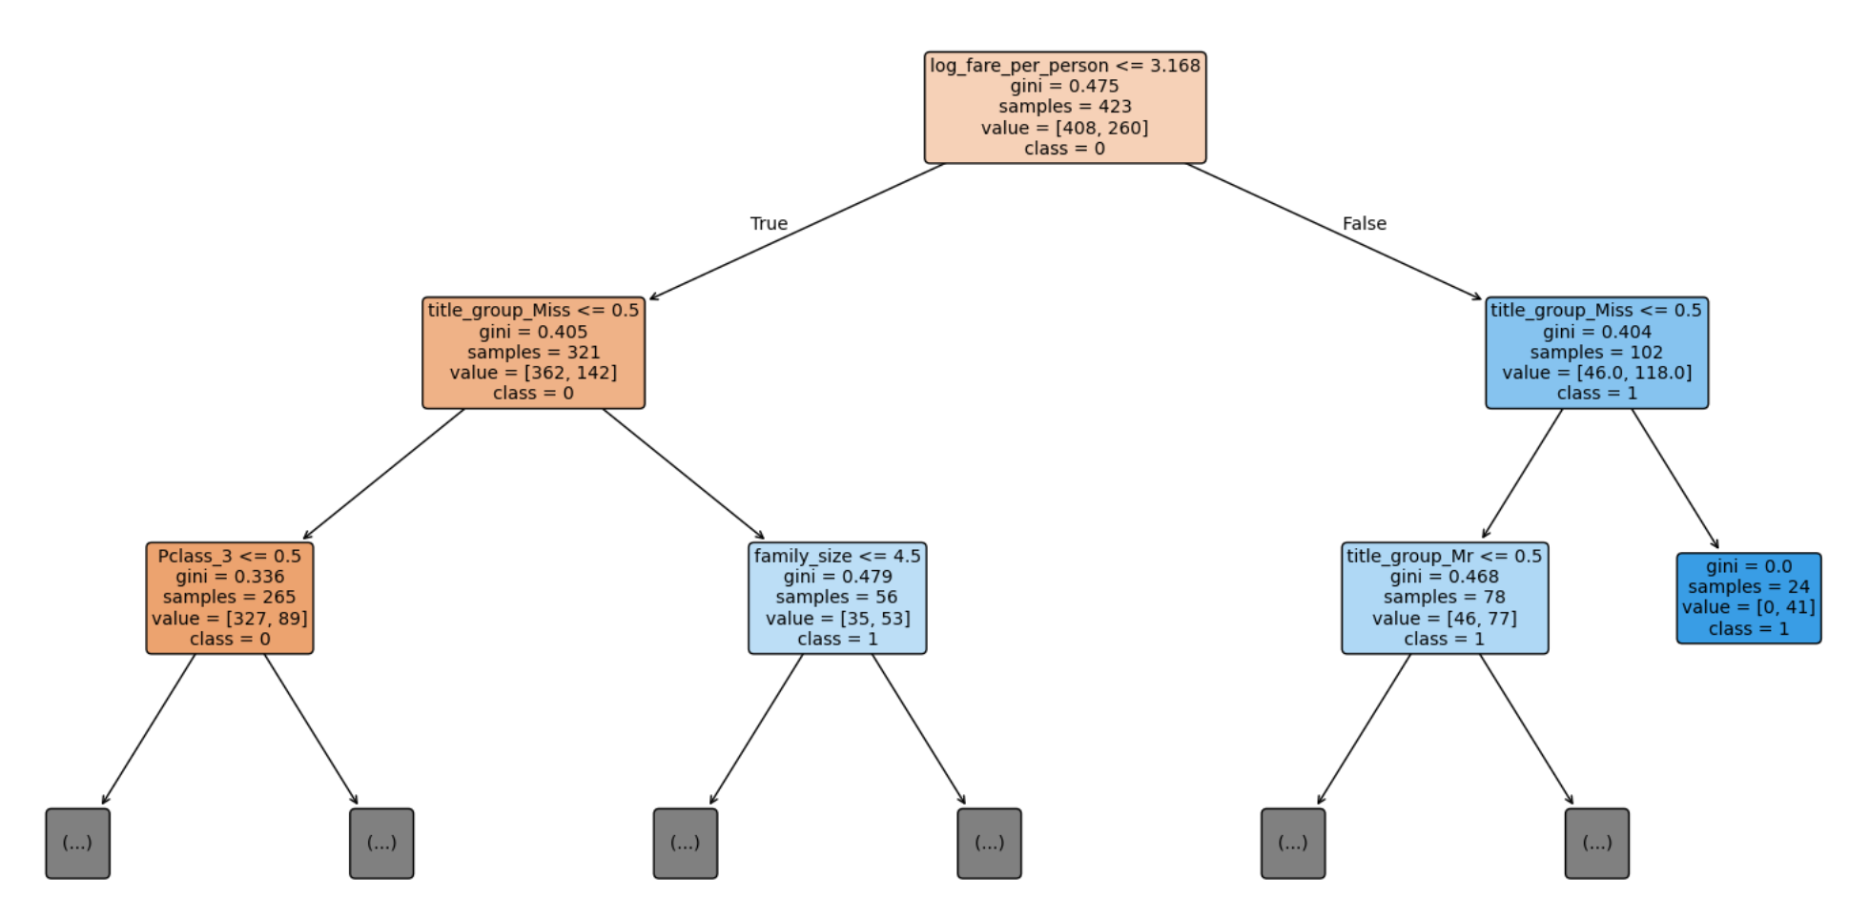
Final Model 1st Tree

Slide 27
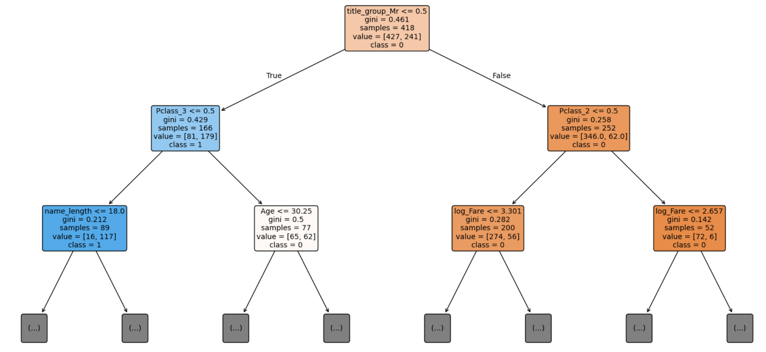
Final Model 501st Tree

Slide 28
K-Nearest Neighbors (KNN) Approach
Why KNN?
Non-Parametric: Captures complex, non-linear patterns without assuming a data distribution.
Logic: Classifies passengers based on similarity ("Tell me who your neighbors are...").
Feature Selection:
Top Predictors: Sex, Fare, and Pclass showed the highest Information Gain.
Goal: Focus on features that maximize separation between Survivors and Non-Survivors.
Notes:
Hi, I’ll be covering our K-Nearest Neighbors model. We chose KNN because it captures non-linear patterns well without making complex assumptions about the data.

Slide 29
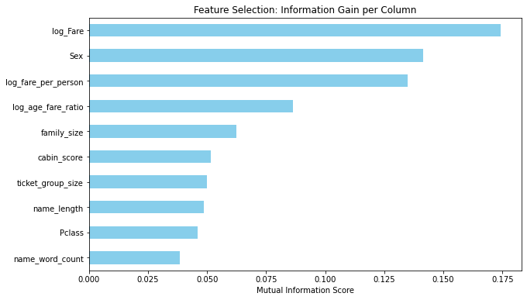

Slide 30
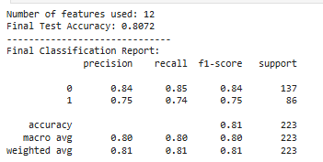
Feature Breakdown (12 Features):
Numerical (Log-Transformed): log_Fare, log_fare_per_person, log_age_fare_ratio (Handles skewness).
Demographic: Age, family_size, Pclass.
Binary/Categorical: is_master, is_child, is_alone, Sex, Embarked, title_group.
Preprocessing:
Applied StandardScaler to all numerical inputs to ensure fair distance calculations.
Notes:
biggest focus here was Feature Engineering. We didn't just use raw data; we created 12 specific features. For example, we used Log Transformations on 'Fare' because the data was highly skewed, and we created binary flags like is_child to help the model find vulnerable groups. Crucially, we applied Standard Scaling to everything. Since KNN calculates distance, we had to ensure a large number like 'Fare' didn't overpower a small number like 'Age'.

Slide 31
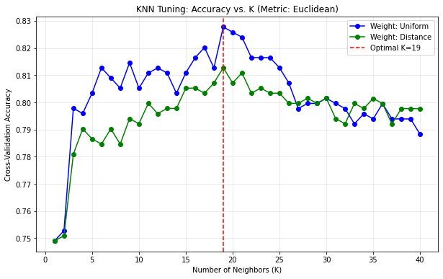
Hyperparameter Tuning
Optimization Strategy:
Used GridSearchCV to tune K (neighbors) and distance metric on the processed feature set.
The "Sweet Spot": K = 19
Why 19? Lower values (K<5) overfitted to the noise of the engineered features. Higher values lost the signal.
Distance Metric: Euclidean
Notes:
To optimize the model, we used Grid Search to test different configurations.
As you can see, the model performed best with 19 neighbors using Euclidean distance and uniform weights. This achieved a validation accuracy of 82.77%.
We found that since we rigorously scaled our data using the Standard Scaler, the standard Euclidean (straight-line) distance was actually more effective than Manhattan distance for identifying these survival clusters.

Slide 32
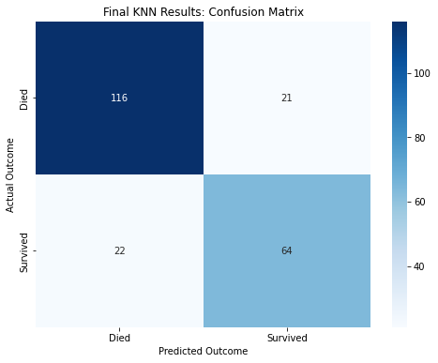
Confusion matrix
Test Accuracy: 80.72%
Key Insight: The model is Conservative.
False Negatives (High): Occasionally misses a survivor.
False Positives (Low): Rarely gives "false hope" (predicting survival when they died).
Notes:
While our accuracy is 80.7%, this matrix reveals our model is 'conservative'—it rarely gives false alarms (False Positives) but occasionally misses a survivor (False Negatives). This proves the model is reliable and not just guessing.

Slide 33
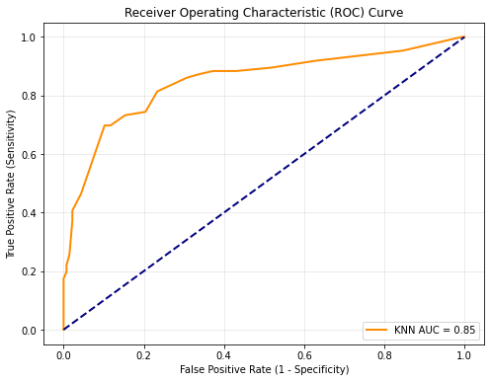
Model Evaluation & Conclusion
ROC Curve Analysis:
AUC Score: 0.85 (0.5 = Guessing, 1.0 = Perfect).
Result: High ability to distinguish Survivors from Non-Survivors.
Curve Shape: Hugs top-left corner <-> High True Positive Rate, Low False Alarms.
Final Conclusion:
Strengths: Simple, interpretable, and effective (80.72% Accuracy).
Key Driver: Feature Engineering (Log-transforms & Ratios) boosted performance.
Limitations & Future Work:
Scalability: KNN is slow on large datasets (calculates distance to every point).
Next Steps: Implement Weighted KNN or Ensemble methods.
Notes:
to conclude, model achieved an AUC score of 0.85, which confirms it is highly reliable.
The curve hugging the top-left corner shows we have a high detection rate for survivors without raising too many false alarms.
While KNN is computationally expensive for massive datasets, for the Titanic problem, it proved to be an excellent baseline.

Slide 34
